Slide 1
SOC 365
Lecture 1
2022-01-30

Slide 2
Agenda for today
Introduction
Course overview
Introduce ourselves
Syllabus
Getting started
Stata: downloading it
Stata: how it really works
Stata: file organization
Stata: downloading and opening data
"Do" files and log files
(around this point): WinStat
Opening and manipulating data in Stata

Slide 3
Course overview (1)
Before going any further, let’s talk about why we’re here. Hopefully everyone had a chance to watch my video introduction to the course — if not, do give a watch today since it also explains where things live on Canvas.
But, I want to also reiterate what this course is about so that you feel a sense of direction. Basically, we are here to learn how to actually manage a diverse array of data-sets that you might actually want to use in research. The data-sets that you’ve already encountered are very likely “clean” ones (can anyone share a set of data that they used in their pre-requisite courses? how much time did you have to spend cleaning it?) — but there is a wide world of interesting social scientific data and accompanying questions out there, and actually using the associated sets is often rather difficult even if you have prior statistical and software training.

Slide 4
Course overview (2)
So, we will spend a lot of time in this course discussing how to best clean data that have all manner of problems, whether they are not formatted in a way that allows immediate use, whether they have strange missing values or even typos, whether the set explicitly contains the variables you want or whether you need to make them, and, at the end, even a bit of programming proper — like something you might see in Week 1 of a computer science course.
Does anyone have any questions or things that they’re especially interested in? The course schedule isn’t completely set in stone, and if there is sufficient collective interest — our textbook, as you will see, is considered by the author himself to be more of a manual than a book that must be read all the way through; I can always swap out weeks.

Slide 5
Course overview (3): the payoff of our course
Here are a few reasons why this is such a valuable set of skills:
If you want to go to graduate school, get a research-related job (e.g. journalism, marketing, public sector), knowing how to do this aspect of research will make you a great research assistant; often, these skills are sort of learned on the fly as you go. Thus, starting out with a strong foundation will make you stand out.
If you are interested in doing your own research, you will need to learn data management skills because no one else is going to do it for you and it has to be done before you can actually conduct research
In either case, good data management is the foundation of good research. Without proper cleaning, your data could have errors or inconsistencies and produce inaccurate results.

Slide 6

Course overview (4): consequences of bad data management i
In this case, insufficient attention to the changes in the meaning of certain codes caused a pair of authors to misidentify sources of growing wage inequality.
The authors who made the mistake are super smart. This problem never goes away!

Slide 7
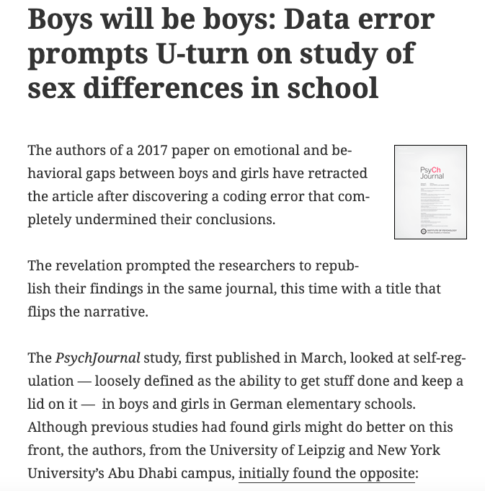
Course overview (5): consequences of bad data management ii
Here, a classic mistake — one that I actually spend a lot of time on in SOC 360 — flipped the results of a study.
If you investigate the Retraction Watch article, you’ll see that this was as simple as a binary variable that represented biological sex being coded in an unusual way which the authors did not notice.

Slide 8
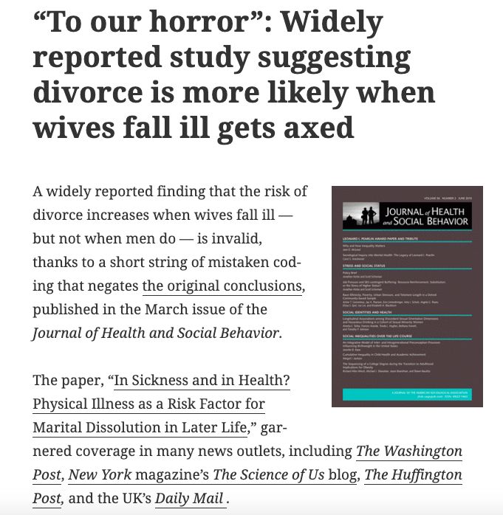
Course overview (6): consequences of bad data management iii
Can you guess the problem with this study?
Yes, a data management mistake — data that were really missing observations (people who left the study before completion) were coded as divorces (see the Retraction Watch article here).

Slide 9
Course overview (7): caveat about the course
So, what is this course not about?
It's not a statistics class, but you will need to know a few things you covered in 360 or the equivalent: two-way tables, means, and correlations.
It’s also not really a class in learning a particular software package. We’ll be using Stata, but you can easily translate what you learn in this class to other software packages, such as R, SAS, SPSS, or even Python.
Second call for questions.

Slide 10
Introductions (1)
Please fold your index card lengthwise and record the following…
Front
Your personal name (what you liked to be called)
Back
Your name as it appears on the roster
Year and major
Something fun about you — hobbies, extracurriculars, what’s next after graduation, etc.
What brings you to the course and what concerns do you have?
If comfortable, pronouns
If comfortable, where is home for you?

Slide 11
Introductions (2)
Now, please place your index card on your desk so that I can read your name. Let’s go around the room and share any of the information on the back you feel comfortable sharing.
I’ll collect these cards and use them to learn your names. When I teach courses for newer students, I also use these to mix up seating by shuffling them and randomly placing them around the room. I’ll probably do that for at least the first few weeks so that we get some people talking with people with whom they might otherwise not get to speak.

Slide 12
Syllabus
Head to the Canvas front-page and download this if you haven’t yet.
We’ll examine this together; I’ll share my screen.

Slide 13
Stata: downloading it (1)
Head to the Campus Software Library (a very useful overall resources, by the way).
Log in to the Library.
Click on “Stata”
Download the version corresponding to your operating system.
(If given the option, select Stata SE).*
Copy/paste the serial number, code, and authorization from the Library page into Stata (no need to register online). This information is specific to you, so copy your own information from this page.
Initiate the program.
Notes:
* The differences are discussed here for those interested. Stata MP runs super-fast (the “MP” means “multiprocessor”), but we just need “SE” (which, in tun, means “standard edition”).

Slide 14
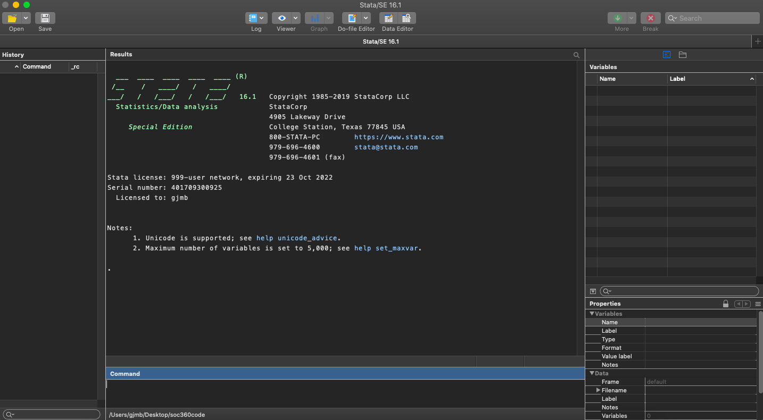
Stata: downloading it (2)
At the end of all of that, you should have something that looks like this.
Raise your hand and let me know if you see something substantially different.

Slide 15
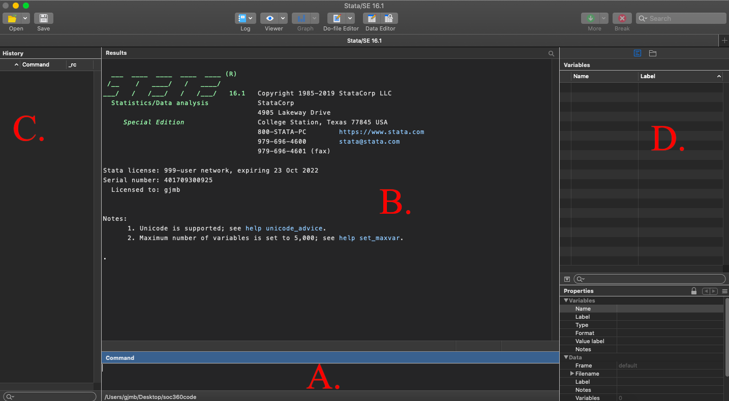
Stata: how it really works (1)
So, what are all these things?
Command window
Results window
History window
Variables window

Slide 16
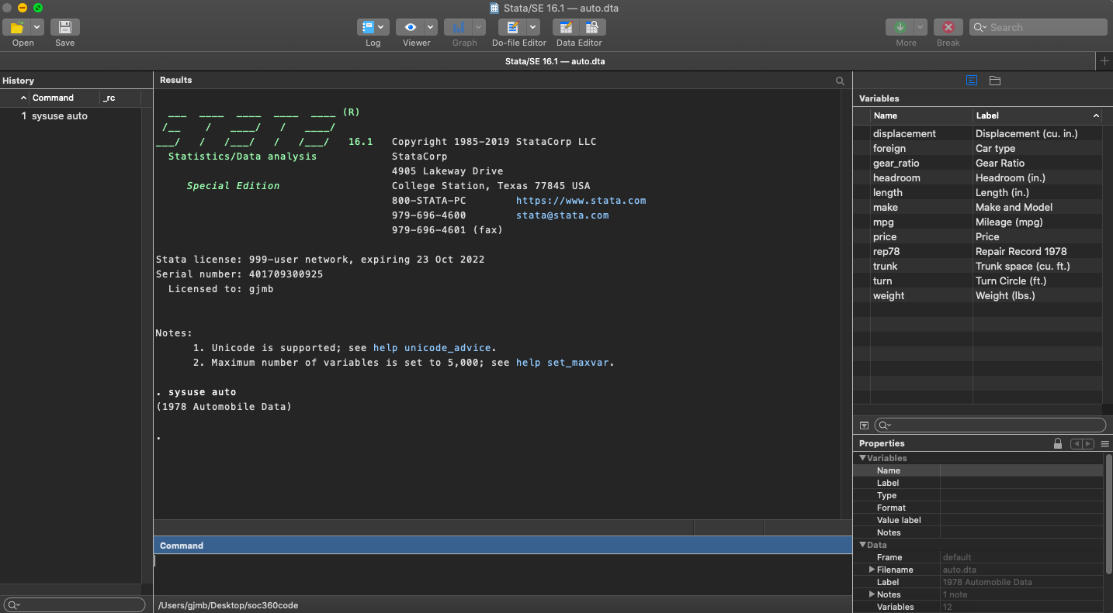
Stata: how it really works (2): the command window i
Let’s go step-by-step. First, we want some data.
In the command window, type sysuse auto and then hit “enter”, which loads a toy dataset.*
Notes:
* I follow the convention of putting Stata commands in Courier to make it obvious what is code and what is not.

Slide 17
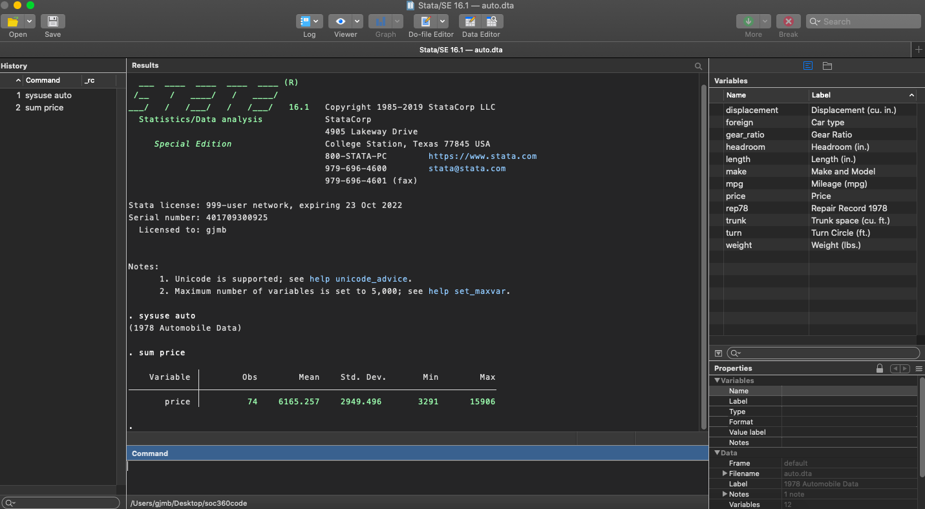
Stata: how it really works (3): the command window ii
So, that is the function of the command window. It allows you to enter commands, or instructions to Stata. Try getting basic summary stats with sum [var]; here I picked price.*
Here is a list of common commands; to see many of them with more context, see my SOC 360 project linked later.
Notes:
* When I put square brackets in code, they are always meta-text meaning there is some flexibility in what you can enter here. Parentheses, by contrast, are often part of your actual Stata code.

Slide 18
Stata: how it really works (4): the results window
Notice that now we have some output in two places. We’ll look at the results window first, which is now populated.
Here, Stata just gives us the output of any (non-graphical) command. Graphs appear as pop-ups; we’ll get to them.*
Notes:
* Many of you have seen graphs already; I know that this course might appear to be moving somewhat slowly, if so, but the purpose is to really learn how to use Stata correctly from the bottom up, something that neither I nor any other regular instructor of SOC 360 require in order to succeed in the course. If you haven’t seen graphs before, or you just want to refresh yourself, try hist [var] for a quantitative variable or graph pie, over([var]) for a qualitative variable.

Slide 19
Stata: how it really works (5): the history window
Importantly, and this is a common and major inefficiency in the use of Stata, we also get a history of commands you’ve run in the left column.
Make sure that you have this window enabled!* It lets you quickly repopulate the command window if you want to slightly modify a command (click once) or just re-run a command (click twice) and you can easily copy/paste from History as well.
Notes:
* To do so, go to view > layout > widescreen (if widescreen is already selected, you may need to flip it to sidebar and then back to widescreen).

Slide 20
Stata: how it really works (6): the variables window
Finally, we also have the variables listed in the top column to the right.
This column displays as many variables as possible; you can use the search bar (look for the magnifying glass) to search for more.

Slide 21
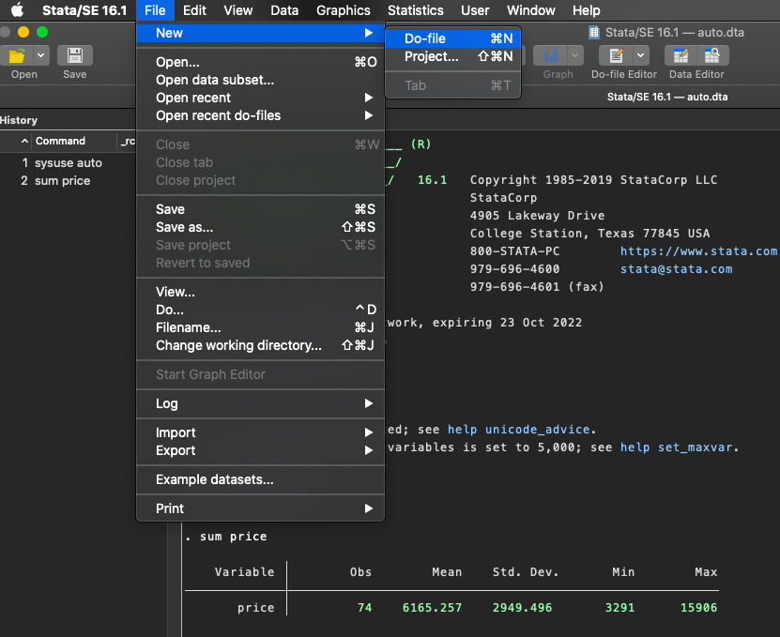
Stata: how it really works (7): the do-file i
This is the newest feature of Stata for most people. To access it, follow this pathway.
Do-files are very important for advanced Stata use. They allow you to save commands for later; a do-file is “code”. Typing commands in the command window does not save them.

Slide 22
Stata: how it really works (8): the do-file ii
So, why the command window at all? It allows you to get immediate results for a command that may, or may not, produce the result you want.
Think about the command window like an etch-a-sketch or a whiteboard. You might use it to play around with ideas. Then, you copy down down (or type up) your thoughts when you’ve come to a preliminary conclusion — except, in Stata, you can just copy/paste rather than literally having to re-type the commands into the do-file!*
The History Window is copy/paste friendly, so once you get a command written correctly, just copy it from History and paste it into your do-file!
Notes:
* This structure — where you have a “sandbox”-type of window and a “script” or “program” window to save things — is common to a variety of programming languages, actually.

Slide 23
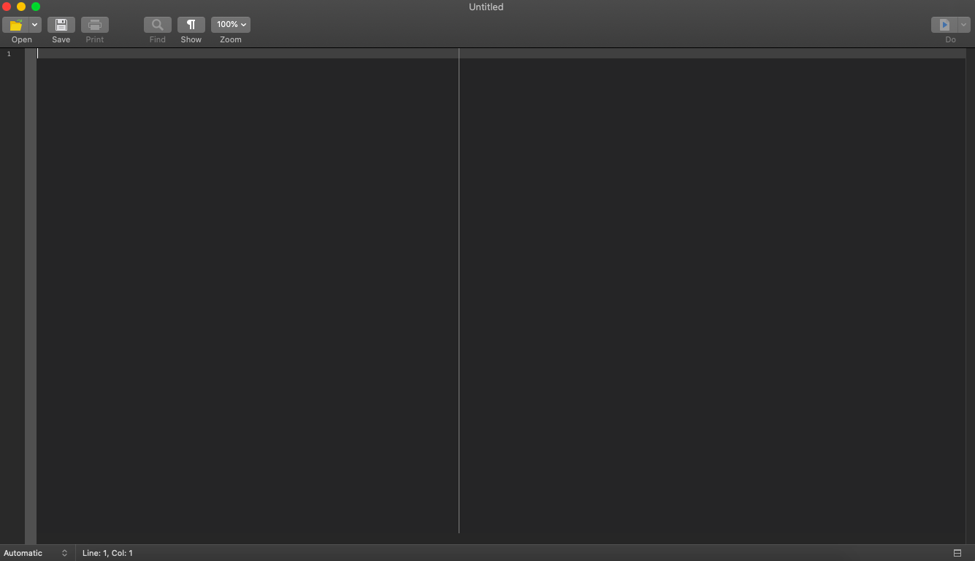
Stata: how it really works (9): the do-file iii
A do-file looks like this when it is empty.
Once we populate this with some code, we can run the entire thing (by hitting “do” or using a keyboard shortcut; on Macs, it is shift+cmd+d) or highlight selected portions and run those, though there are some specific ways that that does and does not work.
So, best practice is to run the entire do-file every time. You can write the code so that this happens pretty quickly and easily.

Slide 24
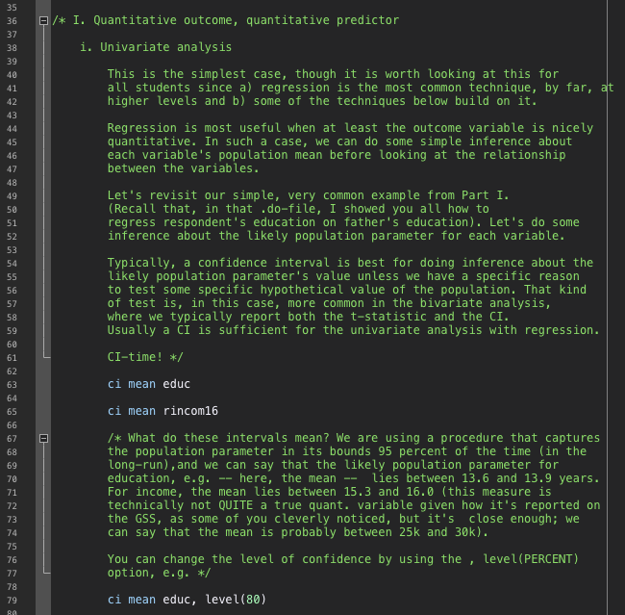
Stata: how it really works (10): the do-file iv
A do-file looks like this when it has code in it. This is a random snippet from the example project code for the final data analysis project for SOC 360, which I teach often.
You do not need to have that advanced math “ready to hand”, even though that course or an equivalent is a prerequisite. But, if this is all old hat to you, and you want to brush up on some basic math in Stata, I put all of my material for the course online free here.*
Notes:
* This code is accessible via the DAP II folder. This hyperlink has been iffy on my computer so here is a direct link: https://drive.google.com/drive/folders/1JOKEUQkO0_vO8a73p_tTtxJxxNe_EQTj.

Slide 25
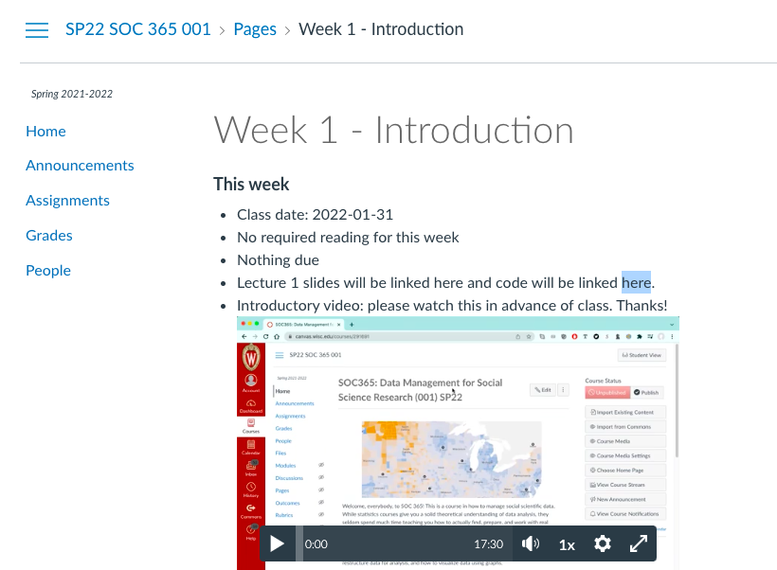
Stata: how it really works (11): the do-file v
Now, I want you all to go ahead and download my do-file from the course website. We’ll transition to that do-file to learn about basic Stata syntax, coming back to these slides in a few spots as needed.
In just a minute, we’ll learn how to store this do-file properly, but for now, you can just download it and then double-click it to open it. I think it will make more sense to finish reviewing the basics of how Stata works before proceeding to file storage.

Slide 26
Stata: how it really works (12): the do-file vi
Here I just want to write down what you should learn from my do-file.
How commands work in the do-file as opposed to the command window
Key takeaway: commands are saved and you can make comments.
How comments work
Key takeaway: use //, the pairing of /* and */, or *(rare).
Why we use our standard “header” in do-files
Proper (and sort of counterintuitive) saving etiquette

Slide 27
Stata: file organization (1)
OK, here is the really key part about file structure. First, you need to know what a folder is, which some students have not had to learn before.* A folder is a “container” for files; folders can be nested in other folders. Files are things such as PDFs, datasets (including Excel and Stata files), FLACs or MP3s, MP4 files, and so on.
We need to make a folder specifically for this course. This is a good idea generally, but for Stata purposes, it is actually nearly-essential.
So, in some location on your computer — I would recommend the desktop or the “documents” folder — you should make a new folder called SOC365 and within it make four folders: “do”, “original_data”, “modified_data”, and “figures”.
Notes:
Do not be afraid to ask me if you do not follow something I’ve done because you have a general “how do computers work” question.

Slide 28
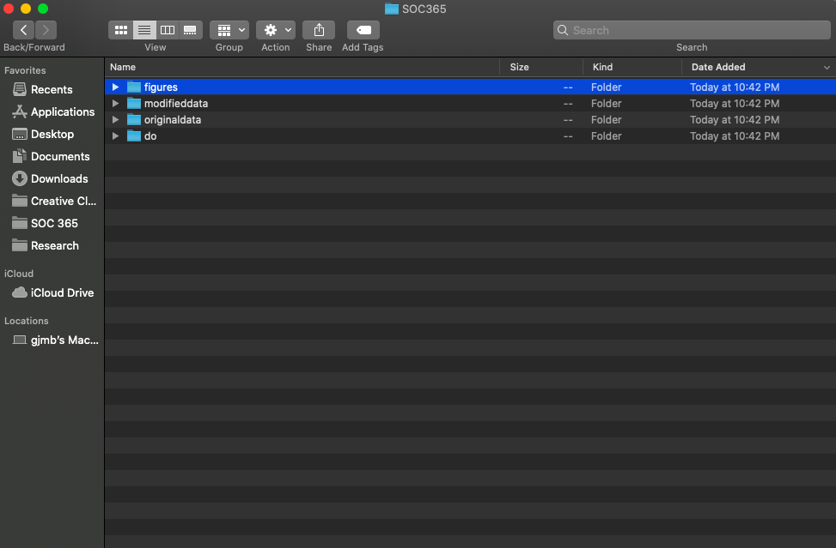
Stata: file organization (2)
The product should look like this. →
As you can see here, if you’re using a Mac OS, you can also pin this folder to your favorites for quick access.*
We also need to go get our data-set for this course and move it into our “original_data” folder.
I’ve linked the data folder here — Canvas was having trouble with the file-size (it’s nearly a gig, so hosting it publicly was easier.Download this folder and either save it directly to “original_data” if your browser prompts you for a location (e.g. in Chrome) ….
… or just download it and move it into this folder (e.g., as Safari seems to require, though I don’t use Safari much).
Notes:
* There is probably something comparable on Windows (most students in my experience use Macs, so my presentation will be a bit Mac-centric, but if you’re on Windows — e.g., you’re using WinStat — I can research anything that doesn’t translate in some obvious way if you ask me :)

Slide 29
Stata: file organization (3)
We are now ready to return to our do-file and set our working directory.
Setting a working directory is just a (very useful) shortcut in Stata that tells Stata in what region of the computer it should look for data and store results. It lets us use much simpler commands when loading data and stores all of our output neatly.

Slide 30
Closing thoughts
Make sure you feel comfortable with the basic set-up and logic of commands and the command window in Stata.
Make sure your file structure is organized in a way that follows mine. Organizing yours differently will require more work on your part (though I don’t absolutely forbid this or anything).
Make sure you understand conceptually what a do-file is, why we use it, and how to do some operations in these files that you might have done only in the command window before.
Due next week: read Mitchell, Chs. 1 and 2 along with reading notes, due 2022-02-07, 9:50 AM, Canvas. Remember that you can always find out which “routine” assignments are due — readings, reading notes, and exercises — by just looking at the next week’s page on Canvas.

